Slide 1


GIT Assignment
Presented By : Shivam Roy

Slide 2
Content
Introduction
Different types of fetch command
My work on fetch command
Conclusion

Slide 3
What is git and why should we use it?
Git is a distributed version control framework that is free and open source. Linux Torvalds, the developer of the linux operating system kernel, created it in 2005.
Git allows a team of people to work together, all using the same file. It helps the team cope with the confusion that tend to happen when multiple people are editing the same file.
Git is the most commonly used version control system. Git tracks the changes make to files, so you have a record of what has been done, and you can revert to specific versions should you ever need to.

Slide 4

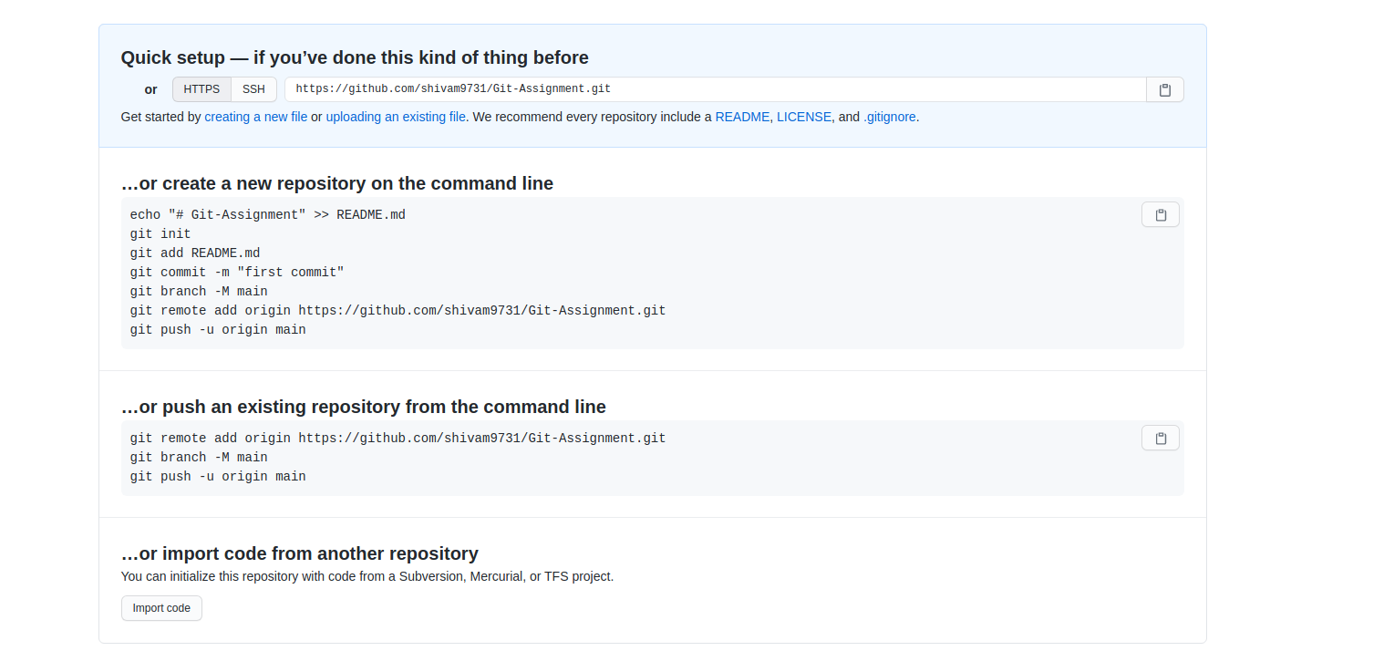
Creating an empty repository on github

Slide 5
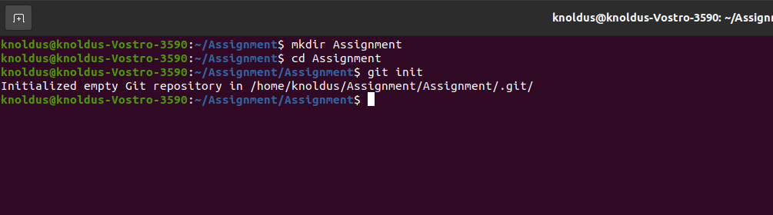
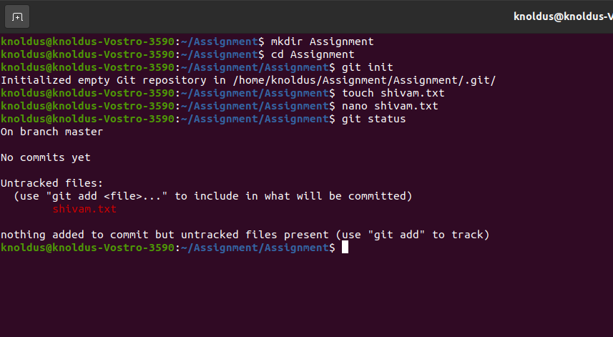
Making an another directory and then initializing git on it by using git init command
Now, making new .txt file naming shivam.txt using touch command and then editing that file using nano command

Slide 6
committing shivam.txt file by using commit command in master branch

Slide 7
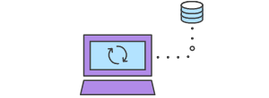
Git fetch command
The git fetch command downloads commits, files, and refs from a remote repository into your local repo. Fetching is what you do when you want to see what everybody else has been working on. It’s similar to svn update in that it lets you see how the central history has progressed, but it doesn’t force you to actually merge the changes into your repository. Git isolates fetched content from existing local content; it has absolutely no effect on your local development work. Fetched content has to be explicitly checked out using the git checkout command. This makes fetching a safe way to review commits before integrating them with your local repository.
Git Fetch

Slide 8

Different types of fetch command
git fetch <remote>
Fetch all of the branches from the repository. This also downloads all of the required commits and files from the other repository.
git fetch <remote><branch>
Same as the above command, but only fetch the specified branch.
git fetch --all
A power move which fetches all registered remotes and their branches:
git fetch --dry-run
The --dry-run option will perform a demo run of the command. It will output examples of actions it will take during the fetch but not apply them.

Slide 9
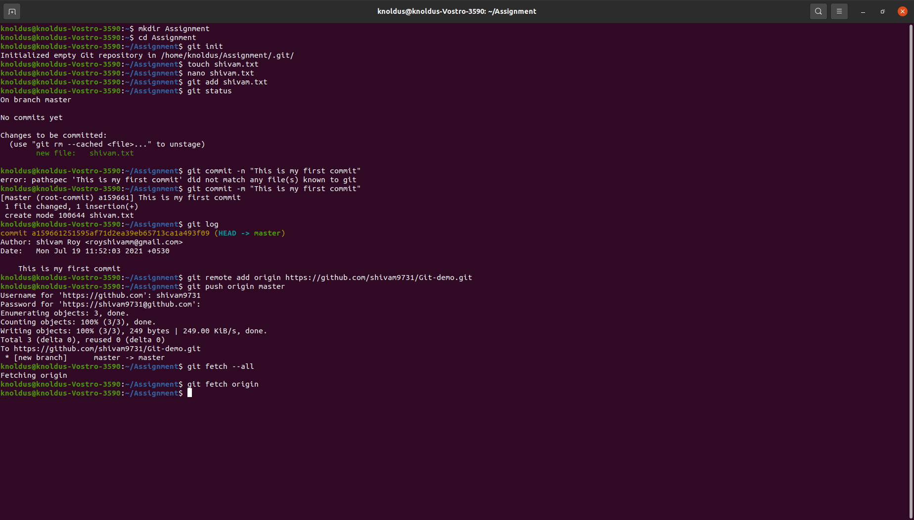
Applying fetch command

Slide 10
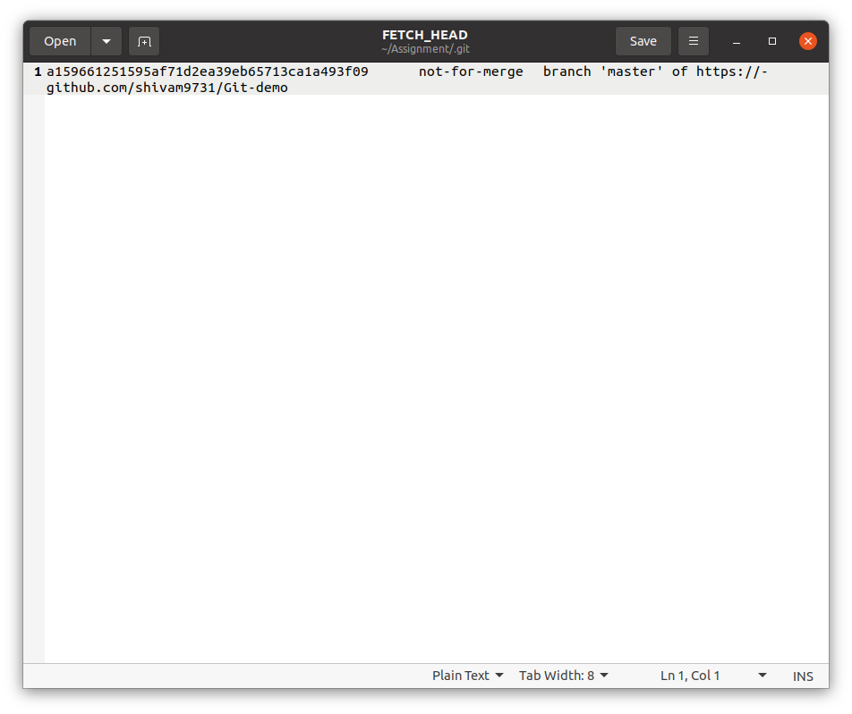

File fetched

Slide 11
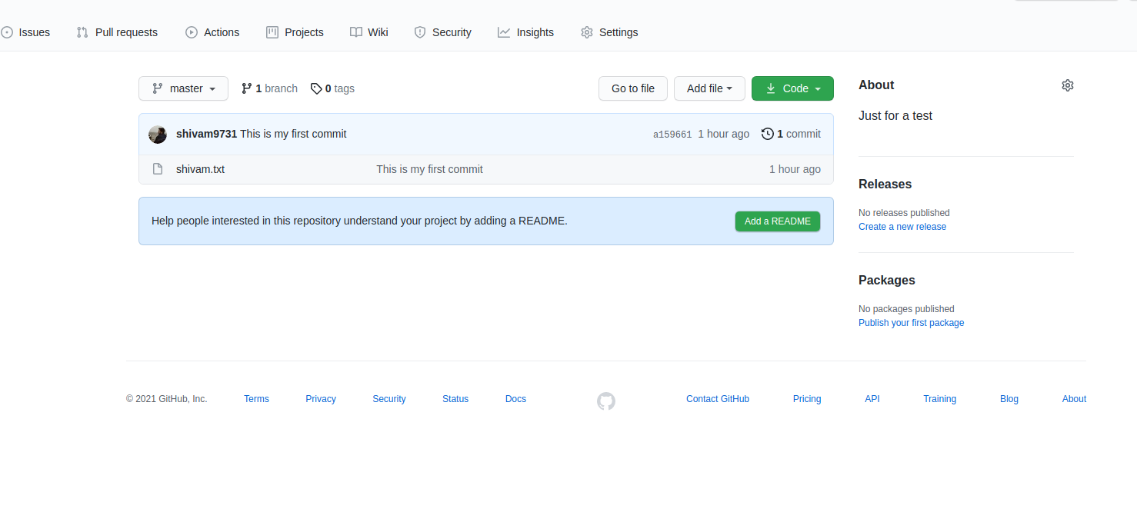
Snippet of file from github repository

Slide 12
My Github link
https://github.com/shivam9731/Git-demo

Slide 13
Thank You

